Slide 1
C Programming Workshop
KJ’s Trinity College of Engineering & Research, Pune
Rushikesh Tanksale

Slide 2
Session I 11AM-1 PM 28 Sept
Introduction to C
Your First C Code
New Line & Comments
Variables in C
Datatypes in C
Format Specifiers
Constants

Slide 3
Start of Session I

Slide 4
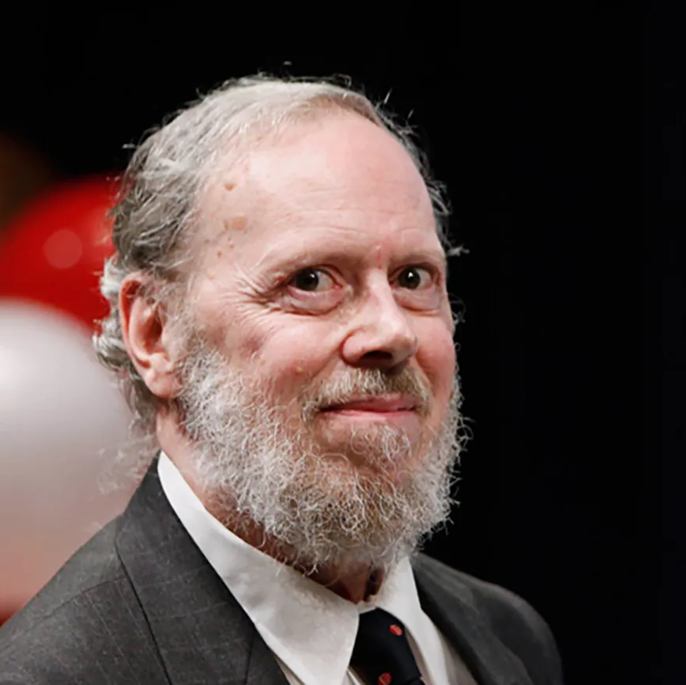

Introduction to C
Developed by Dennis Ritchie at the Bell Laboratories in 1972.
Very Popular Language Despite Being Old
Still used for development
Unreal & Other Game Engine Still need C++ for development
C is strongly associated with UNIX

Slide 5
C Program Code Flow
C program (source code) is sent to preprocessor first. The preprocessor is responsible to convert preprocessor directives into their respective values. The preprocessor generates an expanded source code.
Expanded source code is sent to compiler which compiles the code and converts it into assembly code.
The assembly code is sent to assembler which assembles the code and converts it into object code. Now a simple.obj file is generated.
The object code is sent to linker which links it to the library such as header files. Then it is converted into executable code. A simple.exe file is generated.
The executable code is sent to loader which loads it into memory and then it is executed. After execution, output is sent to console

Slide 6
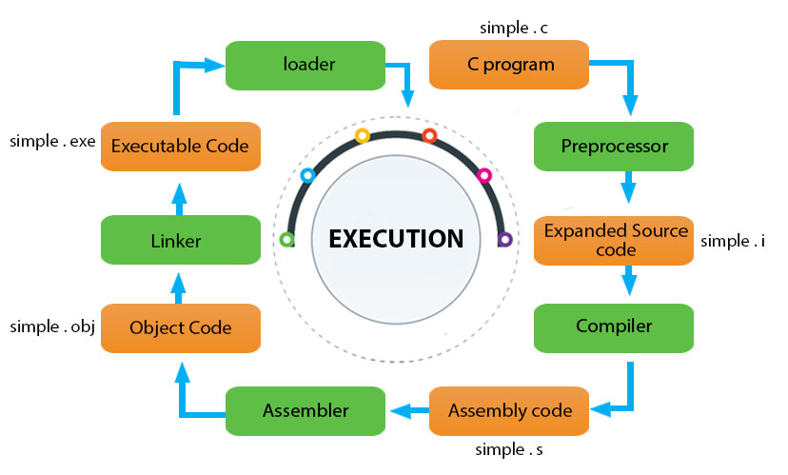
C Program Code Flow

Slide 7
Structure of C Code
Part | Example
Header | #include<stdio.h
Main() | Int main() {
Variable Declaration | Int a=10;
Body | Printf(“%d”,&a);
Return | Return 0; }

Slide 8
Your First C Code
#include <stdio.h> int main() { printf("Hello World!"); return 0; }

Slide 9
Output Statements
So as we can see printf() doesn't add new lines on output console.
So we need to use “\n” in order to get output on next line
Basically the “\n” is called escape sequence.
Apart from “\n” there are other “\t” which adds horizontal tab between output statements.
“\\” will add single backslash while \” will add quotes.

Slide 10
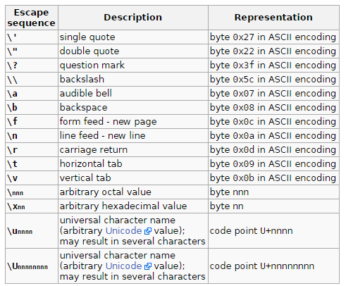
Output continued.

Slide 11
Comments in C
Comments can be used to explain code, and to make it more readable. It can also be used to prevent execution when testing alternative code.
Comments can be singled-lined or multi-lined.
Single Line Comment starts with //.
Multiline comments start with /* and end with */.

Slide 12
Code 2: To Demonstrate Newline & Comments

Slide 13
Variables in C
In C, there are different types of variables (defined with different keywords), for example:
int - stores integers (whole numbers), without decimals, such as 123 or -123
float - stores floating point numbers, with decimals, such as 19.99 or -19.99
char - stores single characters, such as 'a' or 'B'. Char values are surrounded by single quotes

Slide 14
Declaring a Variable
Type variablename = value;
Example
int a =10;
We can even assign value after declaring.
int a;
a=10;
If you assign a new value to an existing variable, it will overwrite the previous value:
Int a=10; //value is 10
a = 15; //value is 15

Slide 15
Data Types in C
The data type specifies the size and type of information the variable will store.
int: Integers are whole numbers that can have both zero, positive and negative values but no decimal values
float & double: are used to store real numbers
The size of float (single precision float data type) is 4 bytes. And the size of double (double precision float data type) is 8 bytes

Slide 16
Data Types in C
char: Keyword char is used for declaring character type variables.
short and long: If you need to use a large number, you can use a type specifier long. Else if it’s a small integer you can use short.
We can check size of variable using sizeof() operator.
signed and unsigned: Signed allows storing of both +ve & -ve numbers while unsigned allows only +ve.

Slide 17
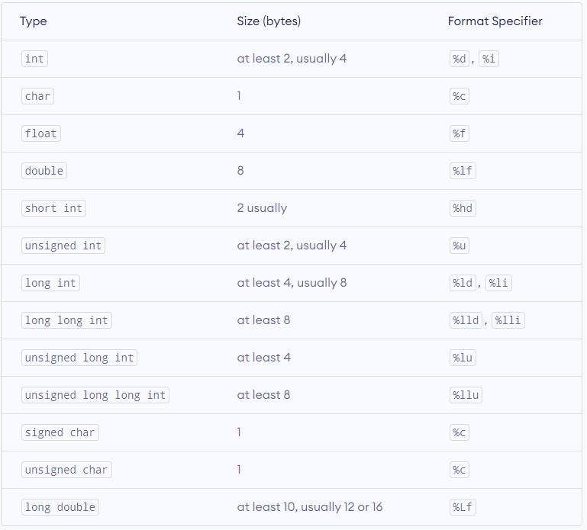
Data Types in C

Slide 18
Printing a variable
In other programming languages you would normally use a print function to display the value of a variable. However, this is not possible in C:
So in order to tackle this issue we need to get familiar to something called format specifiers

Slide 19
Format Specifiers
Format specifiers are used together with the printf() function to tell the compiler what type of data the variable is storing.
It acts like placeholder for variable value
A format specifier starts with a percentage sign % followed by a character

Slide 20
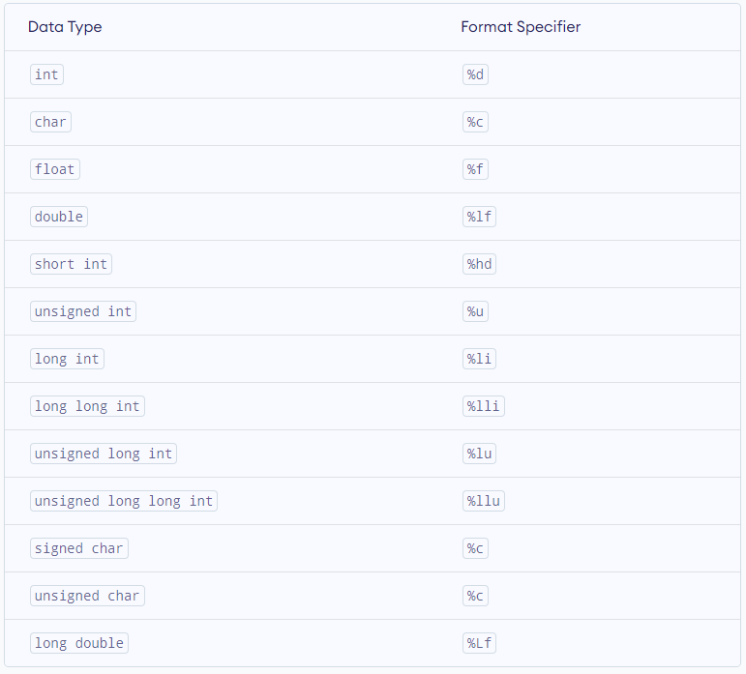
Format Specifiers

Slide 21
Constant in C
When you don't want others (or yourself) to override existing variable values. We use “const” keyword.
When you declare a variable which is constant you must assign value to it.
Another good practice is to write then in UPPER case.

Slide 22
Code 3: To Demonstrate Variable, Data Type & Format Specifiers

Slide 23
End of Session I

Slide 24
Start of Session II

Slide 25
Session II 28 Sept
Operators in C
Looping & Condition Control
Array’s & String
Accepting User Input
Predefined Functions
User defined Functions
Types of User Defined Functions
Function Declaration

Slide 26
Operators in C
Operators are used to perform operations on variables and values.
C divides the operators into the following groups:
Arithmetic operators
Assignment operators
Comparison operators
Logical operators
Bitwise operators

Slide 27
Arithmetic Operators
Operator | Name | Description | Example
+ | Addition | Adds together two values | x + y
- | Subtraction | Subtracts one value from another | x - y
* | Multiplication | Multiplies two values | x * y
/ | Division | Divides one value by another | x / y
% | Modulus | Returns the division remainder | x % y
++ | Increment | Increases the value of a variable by 1 | ++x
-- | Decrement | Decreases the value of a variable by 1 | --x
* | Multiplication | Multiplies two values | x * y

Slide 28
Assignment Operators
Operator | Example | Same As
= | x = 5 | x = 5
+= | x += 3 | x = x + 3
-= | x -= 3 | x = x - 3
*= | x *= 3 | x = x * 3
/= | x /= 3 | x = x / 3
%= | x %= 3 | x = x % 3
&= | x &= 3 | x = x & 3
|= | x |= 3 | x = x | 3
^= | x ^= 3 | x = x ^ 3
>>= | x >>= 3 | x = x >> 3
<<= | x <<= 3 | x = x << 3

Slide 29
Comparison Operators
Operator | Name | Example
== | Equal to | x == y
!= | Not equal | x != y
> | Greater than | x > y
< | Less than | x < y
>= | Greater than or equal to | x >= y
<= | Less than or equal to | x <= y

Slide 30
Logical Operators
Operator | Name | Description | Example
&& | Logical and | Returns true if both statements are true | x < 5 && x < 10
|| | Logical or | Returns true if one of the statements is true | x < 5 || x < 4
! | Logical not | Reverse the result, returns false if the result is true | !(x < 5 && x < 10)

Slide 31
Looping & Condition Control
We learned comparison operators from previous slide
C supports the usual logical conditions from mathematics:
Less than: a < b
Less than or equal to: a <= b
Greater than: a > b
Greater than or equal to: a >= b
Equal to a == b
Not Equal to: a != b

Slide 32
Looping & Condition Control
You can use these conditions to perform different actions for different decisions.
C has the following conditional statements:
Use if to specify a block of code to be executed, if a specified condition is true
Use else to specify a block of code to be executed, if the same condition is false
Use else if to specify a new condition to test, if the first condition is false
Use switch to specify many alternative blocks of code to be executed

Slide 33
If, Else and Else If
Use the if statement to specify a block of C code to be executed if a condition is true.
Use the else statement to specify a block of code to be executed if the condition is false.
Use the else if statement to specify a new condition if the first condition is false

Slide 34
Code 4: If-Else If- Else Demo

Slide 35
C Switch Case
Instead of writing many if..else statements, you can use the switch statement.
The switch statement selects one of many code blocks to be executed:

Slide 36
Break & Default Keyword
The break Keyword
When C reaches a break keyword, it breaks out of the switch block.
This will stop the execution of more code and case testing inside the block.
The default Keyword
The default keyword specifies some code to run if there is no case match:

Slide 37
Code 5: C Switch Case Demo

Slide 38
Loops
Loops can execute a block of code as long as a specified condition is reached.
Loops are handy because they save time, reduce errors, and they make code more readable.

Slide 39
While Loop
The while loop loops through a block of code as long as a specified condition is true:

Slide 40
The Do/While Loop
The do/while loop is a variant of the while loop. This loop will execute the code block once, before checking if the condition is true, then it will repeat the loop as long as the condition is true.

Slide 41
Code 6: While Loop Demo Code 7: Do While Loop

Slide 42
The For Loop
When you know exactly how many times you want to loop through a block of code, use the for loop instead of a while loop

Slide 43
Code 8: For Loop Demo

Slide 44
Break Keyword
The break statement can also be used to jump out of a loop.

Slide 45
Continue Keyword
The continue statement breaks one iteration (in the loop), if a specified condition occurs, and continues with the next iteration in the loop.

Slide 46
Any Questions?
So, Its Wrapped for the Day

Slide 47
Session 3 11AM-1PM
C User Input
Array & Strings
Recursion
Memory Address & Pointers
Mathematical Functions
Structures in C
Union in C
Introduction to C++
Comparison between C & C++

Slide 48
C User Input
You have already learned that printf() is used to output values in C.
To get user input, you can use the scanf() function:

Slide 49
Array
Arrays are used to store multiple values in a single variable, instead of declaring separate variables for each value.
To create an array, define the data type (like int) and specify the name of the array followed by square brackets [].
To insert values to it, use a comma-separated list, inside curly braces:

Slide 50
String
Strings are used for storing text/characters.
For example, "Hello World" is a string of characters.
Unlike many other programming languages, C does not have a String type to easily create string variables. However, you can use the char type and create an array of characters to make a string in C:

Slide 51
Code 9: Array, String and User Input Demo.

Slide 52
C Functions
A function is a block of code that performs a specific task.
Suppose, you need to create a program to create a circle and color it. You can create two functions to solve this problem:
create a circle function
create a color function
Dividing a complex problem into smaller chunks makes our program easy to understand and reuse.

Slide 53
Predefined or Standard Library Functions
Standard library functions
The standard library functions are built-in functions in C programming.
These functions are defined in header files. For example,
The printf() is a standard library function to send formatted output to the screen (display output on the screen). This function is defined in the stdio.h header file. Hence, to use the printf()function, we need to include the stdio.h header file using #include <stdio.h>.
The sqrt() function calculates the square root of a number. The function is defined in the math.h header file.

Slide 54
User Defined Functions
You can also create functions as per your need. Such functions created by the user are known as user-defined functions.
The execution of a C program begins from the main() function.
When the compiler encounters functionName();, control of the program jumps to function and the execution starts.
The control of the program jumps back to the main() function once code inside the function definition is executed.

Slide 55
Advantages of User Defined Function
Advantages of user-defined function
The program will be easier to understand, maintain and debug.
Reusable codes that can be used in other programs
A large program can be divided into smaller modules. Hence, a large project can be divided among many programmers.

Slide 56
Code 10: User Defined Function

Slide 57
Types of User Defined Function
No Argument Passed and No Return Value
No Arguments Passed But Returns a Value
Argument Passed But No Return Value
Argument Passed and Returns a Value

Slide 58
No Argument Passed and No Return Value
Void userfunction()
{
}

Slide 59
No Argument Passed But Returns a Value
Void userfunction()
{
return 0;
}

Slide 60
Argument Passed But No Return Value
Void userfunction(datatype variable name)
{
}

Slide 61
Argument Passed And a Returns Value
Void userfunction(datatype variable name)
{
Return variablename;
}

Slide 62
Code 11: Types of User Defined Function

Slide 63
Recursion
A function that calls itself is known as a recursive function. And, this technique is known as recursion.
The recursion continues until some condition is met to prevent it.
To prevent infinite recursion, if...else statement (or similar approach) can be used where one branch makes the recursive call, and other doesn't.

Slide 64
Code 12: Recursion Example

Slide 65
Memory Address & Pointer
Pointers (pointer variables) are special variables that are used to store addresses rather than values.
If you have a variable var in your program, &var will give you its address in the memory.
We have used address numerous times while using the scanf() function.
int* p;

Slide 66
Code 13: Pointer Example

Slide 67
C Dynamic Memory Allocation
C malloc()
The name "malloc" stands for memory allocation.
The malloc() function reserves a block of memory of the specified number of bytes. And, it returns a pointer of void which can be casted into pointers of any form.

Slide 68
C Dynamic Memory Allocation
C calloc()
The name "calloc" stands for contiguous allocation.
The malloc() function allocates memory and leaves the memory uninitialized, whereas the calloc() function allocates memory and initializes all bits to zero.

Slide 69
C Dynamic Memory Allocation
C free()
Dynamically allocated memory created with either calloc() or malloc() doesn't get freed on their own. You must explicitly use free() to release the space.

Slide 70
C Dynamic Memory Allocation
C realloc()
If the dynamically allocated memory is insufficient or more than required, you can change the size of previously allocated memory using the realloc() function.

Slide 71
Code 14: C Dynamic Memory Allocation

Slide 72
Mathematical Functions
C Programming allows us to perform mathematical operations through the functions defined in <math.h> header file. The <math.h> header file contains various methods for performing mathematical operations such as sqrt(), pow(), ceil(), floor() etc.

Slide 73
Mathematical Functions
No. | Function | Description
1) | ceil(number) | rounds up the given number. It returns the integer value which is greater than or equal to given number.
2) | floor(number) | rounds down the given number. It returns the integer value which is less than or equal to given number.
3) | sqrt(number) | returns the square root of given number.
4) | pow(base, exponent) | returns the power of given number.
5) | abs(number) | returns the absolute value of given number.

Slide 74
Code 15: Mathematical Functions

Slide 75
Structures in C
In C, there are cases where we need to store multiple attributes of an entity. It is not necessary that an entity has all the information of one type only. It can have different attributes of different data types. For example, an entity Student may have its name (string), roll number (int), marks (float). To store such type of information regarding an entity student, we have the following approaches:
Construct individual arrays for storing names, roll numbers, and marks.
Use a special data structure to store the collection of different data types.

Slide 76
Structure
Structure in c is a user-defined data type that enables us to store the collection of different data types. Each element of a structure is called a member. Structures ca; simulate the use of classes and templates as it can store various information
The ,struct keyword is used to define the structure. Let's see the syntax to define the structure in c.

Slide 77
Access Members of a Structure
There are two types of operators used for accessing members of a structure.
. - Member operator
-> - Structure pointer operator

Slide 78
Structure Syntax
struct structure_name
{
data_type member1;
data_type member2;
.
.
data_type memeberN;
};

Slide 79
Keyword typedef
We use the typedef keyword to create an alias name for data types. It is commonly used with structures to simplify the syntax of declaring variables.

Slide 80
Code 16: Structure Example

Slide 81
Union
A union is a user-defined type similar to structs in C except for one key difference.
Structures allocate enough space to store all their members, whereas unions can only hold one member value at a time.

Slide 82
Union Syntax
union car
{ char name[50];
int price;
};
int main()
{ union car car1, car2, *car3;
return 0;
}

Slide 83
Access Members of a Union
Access members of a union
We use the . operator to access members of a union.
And to access pointer variables, we use the -> operator.

Slide 84
Code 17: Union Example

Slide 85
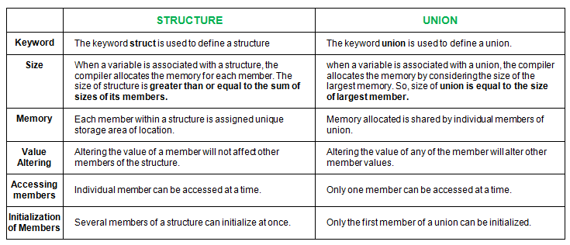
Union vs Structure

Slide 86
Code 18: Structure vs Union

Slide 87
Structure vs Union
Why this difference in the size of union and structure variables?
Here, the size of sJob is 40 bytes because
the size of name[32] is 32 bytes
the size of salary is 4 bytes
the size of workerNo is 4 bytes
However, the size of uJob is 32 bytes. It's because the size of a union variable will always be the size of its largest element. In the above example, the size of its largest element, (name[32]), is 32 bytes.
With a union, all members share the same memory.

Slide 88
Introduction to C++
C++ is a cross-platform language that can be used to create high-performance applications.
C++ was developed by Bjarne Stroustrup, as an extension to the C language.
C++ gives programmers a high level of control over system resources and memory.
The language was updated 4 major times in 2011, 2014, 2017, and 2020 to C++11, C++14, C++17, C++20.

Slide 89
Why Use C++
C++ is one of the world's most popular programming languages.
C++ can be found in today's operating systems, Graphical User Interfaces, and embedded systems.
C++ is an object-oriented programming language which gives a clear structure to programs and allows code to be reused, lowering development costs.
C++ is portable and can be used to develop applications that can be adapted to multiple platforms.
C++ is fun and easy to learn!
As C++ is close to C, C# and Java, it makes it easy for programmers to switch to C++ or vice versa.

Slide 90
Difference between C and C++
C++ was developed as an extension of C, and both languages have almost the same syntax.
The main difference between C and C++ is that C++ support classes and objects, while C does not.

Slide 91
Comparison Between C & C++
C | C++
C was developed by Dennis Ritchie between the year 1969 and 1973 at AT&T Bell Labs. | C++ was developed by Bjarne Stroustrup in 1979.
C does no support polymorphism, encapsulation, and inheritance which means that C does not support object oriented programming. | C++ supports polymorphism, encapsulation, and inheritance because it is an object oriented programming language.
C is a subset of C++. | C++ is a superset of C.
C contains 32 keywords. | C++ contains 63 keywords.
For the development of code, C supports procedural programming. | C++ is known as hybrid language because C++ supports both procedural and object oriented programming paradigms.
Data and functions are separated in C because it is a procedural programming language. | Data and functions are encapsulated together in form of an object in C++.
C does not support information hiding. | Data is hidden by the Encapsulation to ensure that data structures and operators are used as intended.

Slide 92
Comparison Between C & C++
C | C++
Built-in data types is supported in C. | Built-in & user-defined data types is supported in C++.
C is a function driven language because C is a procedural programming language. | C++ is an object driven language because it is an object oriented programming.
Function and operator overloading is not supported in C. | Function and operator overloading is supported by C++.
C is a function-driven language. | C++ is an object-driven language
Functions in C are not defined inside structures. | Functions can be used inside a structure in C++.
Namespace features are not present inside the C. | Namespace is used by C++, which avoid name collisions.
Header file used by C is stdio.h. | Header file used by C++ is iostream.h.
Reference variables are not supported by C. | Reference variables are supported by C++.
Virtual and friend functions are not supported by C. | Virtual and friend functions are supported by C++.

Slide 93
Comparison Between C & C++
C | C++
C does not support inheritance. | C++ supports inheritance.
Instead of focusing on data, C focuses on method or process. | C++ focuses on data instead of focusing on method or procedure.
C provides malloc() and calloc() functions for dynamic memory allocation, and free() for memory de-allocation. | C++ provides new operator for memory allocation and delete operator for memory de-allocation.
Direct support for exception handling is not supported by C. | Exception handling is supported by C++.
scanf() and printf() functions are used for input/output in C. | cin and cout are used for input/output in C++.
C structures don’t have access modifiers. | C ++ structures have access modifiers.
C follows the top-down approach | C++ follows the Bottom-up approach
C does not support inheritance. | C++ supports inheritance.
Instead of focusing on data, C focuses on method or process. | C++ focuses on data instead of focusing on method or procedure.

Slide 94
Comparison Between C & C++
C | C++
There is no strict type checking in C programming language. | Strict type checking in done in C++. So many programs that run well in C compiler will result in many warnings and errors under C++ compiler.
C does not support overloading | C++ does support overloading

Slide 95
Code 19: C vs C++ Code

Slide 96

Thank you
Scan the below QR for my social media handles

